Slide 1

Post 16 Collection
Software Development Forum
24 August 2016

Slide 2
Agenda
Tea and coffee will be available from 10.30
11.00 Introductions and aims for the day
  Data quality issues with the Post-16 collection
  Post-16 performance measures (learning activity level data) – Bethan Milton
  Funding & planning (programme level data) – Geoff Hicks
  Discussion on potential improvements
12.30 Lunch
13.00 Introducing QNs into the Post-16 collection
  Benefits from Welsh Government perspective
  Easier to map to programmes via SSA (sector subject area)
  Easier to map attainment to awarding organisations
  Single source of data for all stakeholders
  Schools/LAs can calculate performance data for self evaluation
What do software suppliers have in their systems currently for QNs?
Automation of Guided Contact Hours
What do software suppliers need from WG?
15:00 Next steps and close

Slide 3

  Data quality issues with the Post-16 collection

Slide 4

Post-16 Collection
Bethan Milton
Post-16 Quality and Data Management
August 2016

Slide 5

Why do we need a whole year collection?
School sixth forms and FE institutions can be measured on the same basis:
  Retention – did the learner stay until the end of the course?
  Achievement – what outcome did they achieve?
post-16 collection does not have outcomes so need to match learning activities to outcomes (in Welsh Examinations Database).

Slide 6
What is the data used for?
not used in the current level 3 threshold or wider points score measures
to calculate learning activity completion rates;
when combined with examination outcomes, to calculate success (of all learning activities that were started, how many were successfully completed and achieved);

Slide 7
Learning activity completion rates
Experimental statistics
Issues with data quality
Will not be published in this format

Slide 8
How is the base cohort identified?
all learning activities which were:
  expected to complete within the academic year; or
  were expected to complete prior to the academic year, but terminated within the academic year.
to ensure learners are included in the calculations of the year they were supposed to complete.

Slide 9
How is completion calculated?
No. of Completed Learning Activities
No. of Terminated Learning Activities
Derived using CompletionStatus field
Includes all learning activities in the base cohort
Completed Learning Activities - CompletionStatus = 2
Terminated Learning Activities - CompletionStatus = 2 or 3

Slide 10
Data quality issues
Pupils recorded on the January 2015 PLASC but not in post-16 collection
Anomalies in the proportion of Key Skills provision (varied considerably between schools and LAs)
Contradictions between ‘Completion status’ and ‘Expected end date’

Slide 11
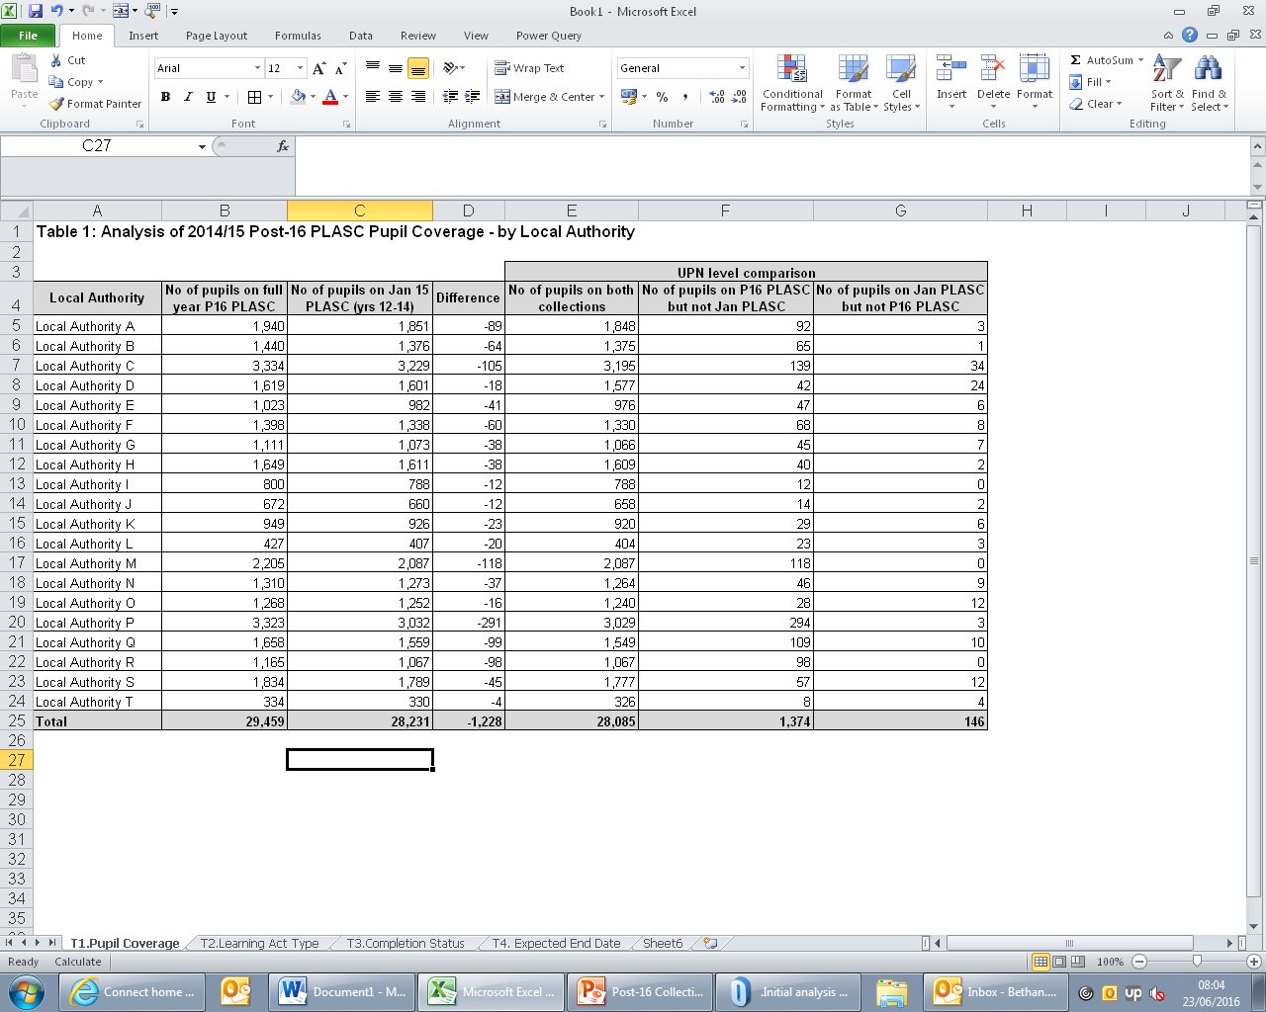
Data Quality: Pupil Coverage
All learners on the January PLASC should be included in the post-16 return

Slide 12
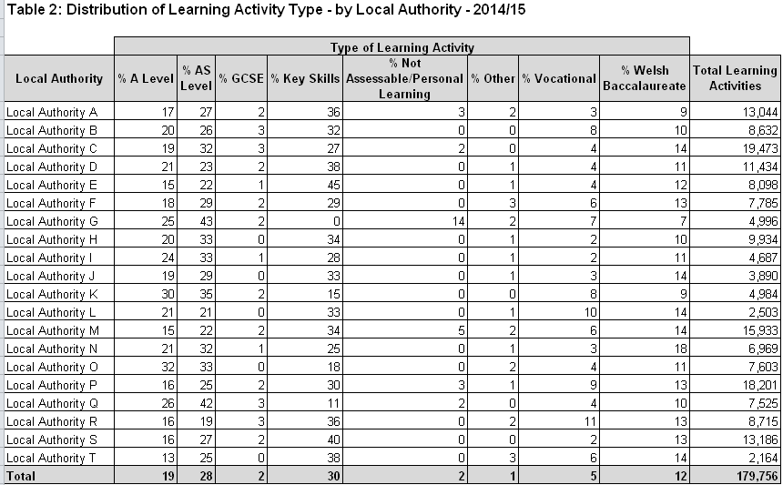
Data Quality: Learning Activities
All learning activities should be included
Generally automatically extracted from MIS
Where timetable details are not input (eg Key Skills), information must be manually entered
Indicates under-reporting of learning activities which skews learning activity completion rates

Slide 13
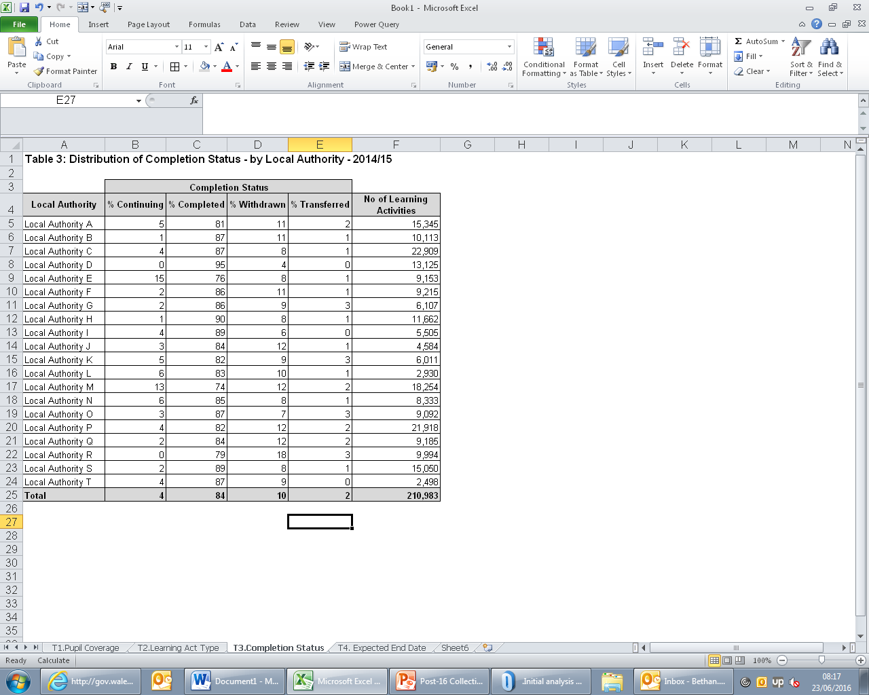
Data Quality: Completion Status
Only those completed or withdrawn included in the calculation
Completion status is similar to the previous year - slightly higher proportion of withdrawn
Continuing – two year courses (eg BTEC extended diplomas)?

Slide 14
Questions
Are there changes that can be made to the MIS systems to help improve data quality?
Do you have any other feedback?

Slide 15


  Funding & planning
  £££

Slide 16

System Cynllunio a
Chyllido Ôl-16
Post-16 Planning and
Funding System
Geoff Hicks

Slide 17

Trosolwg o’r System - System Overview
Fframwaith ar gyfer newid
Rhaglenni
System yn seiliedig ar ddeilliannau
Framework for change
Programmes
Outcome based system

Slide 18
Rhaglenni fel Sylfaen Programmes as the
Foundation
Rhaglenni fel prif gerbyd i gyflenwi dysgu
Dim ond rhaglenni cymwys y bydd modd eu cyllido
Cyfeiriadur Rhaglenni
Programmes as the primary vehicle to deliver learning
Only eligible programmes will be fundable
Programmes Directory

Slide 19

Rhaglenni fel Sylfaen
Programmes as the Foundation
Relevant work experience
Local needs / variation
Main qualifications
Core – WBQ or equivalent
Which as a minimum meets the requirements of the core 14-19 Pathways

Slide 20


Rhaglenni fel Sylfaen
Programmes as the Foundation

Slide 21
Rhaglenni fel Sylfaen
Programmes as the Foundation
Gwerthoedd cyffredin y rhaglenni
Gwerthoedd cychwynnol y rhaglenni a osodwyd i sicrhau sefydlogrwydd
Bydd gwerthoedd y rhaglenni’n seiliedig ar ddysgwyr nodweddiadol
Common programme values
Initial programme values set to ensure stability
Programme values will be based on typical learners

Slide 22
Enghraifft o Werth Rhaglen: Academaidd
Example of Programme Value: Academic
 | Cynnwys/ Content | Pwysoliad/ Weighting | Oriau/ Hours | Cyfanswm Oriau wedi’u Pwysoli/ Total Weighted Hours
Craidd/Core | 3*SHC/ESW Craidd/ Learning Core BC/WB | 1 | 3*30 45 | 135
Prif Gymhwyster/ Main | 3*AS | 1.2 | 405 | 486
Eraill/Other |  | 1 | 75 | 75
Cyfanswm/ Total |  |  | 630 | 711
Cyfanswm Oriau/ Total Hours | Cyfradd Uned/ Unit Rate | Gwerth y Raglen/ Programme value
711 | £4.75 | £3,377
Gwerth/Value
£3,377

Slide 23
Casglu data ol-16 Post-16 data collection
Defnyddir i bennu dyraniadau drwy ddefnyddio gwerthoedd rhaglen gyfartalog fesul Awdurdod Lleol
Used to derive annual allocations via use of average programme values per Local Authority

Slide 24
Casglu data ol-16 Post-16 data collection
Defnyddir i fonitro darpariaeth yn erbyn gofynion rhaglenni a gwerthoedd
Used to monitor delivery against programme specifications and values

Slide 25
Meysydd Allweddol Key Fields
MAE POB MAES YN ALLWEDDOL!!
Cyfeirnod y Gweithgaredd Dysgu (gan gynnwys cod y rhaglen)
Categori’r Gweithgaredd Dysgu
Oriau Cyswllt o dan Arweiniad
ALL FIELDS ARE KEY!!
Learning Activity Reference (inc. Programme code)
Learning Activity Category
Guided Contact Hours

Slide 26
Y rheol 8 wythnos 8 week rule
Dylai cynnwys y rhaglen ddysgu adlewyrchu gofynion y rhaglen ar ôl 8 wythnos
The Programme of study should reflect the programme being undertaken after 8 weeks

Slide 27
Oriau Cyswllt dan GCH
Arweiniad
GCH should be the total number of GCH timetabled for the Programme of study
Dylai’r oriau cyswllt cyfateb i’r nifer o oriau cyswllt sydd wedi’u hamserlennu

Slide 28
Problemau gyda’r casgliad diweddaraf
Issues with latest collection

Slide 29
Cwestiynau Questions
Sut y gellir newid yr adroddiadau rheoli?
Oes llefydd lle mae angen rhagor o gyfarwyddyd?
Pa help ychwanegol allwn ni ei gynnig i sicrhau cywirdeb eich data?
Oes gennych chi unrhyw adborth arall?
How could the management reports be changed?
Are there any areas where you feel further guidance is needed?
Is there more we could do to help you ensure the accuracy of your data?
Do you have any other feedback?

Slide 30

  How to improve ?

Slide 31

  Lunch

Slide 32

  Introducing QNs into the Post-16 collection
Leap of faith or opportunity to rise and improve?

Slide 33
Benefits from Welsh Government perspective
  Easier to map to programmes via SSA (sector subject area)
  Easier to map attainment to awarding organisations
  Single source of data for all stakeholders
  Schools/LAs can calculate performance data for self evaluation

Slide 34
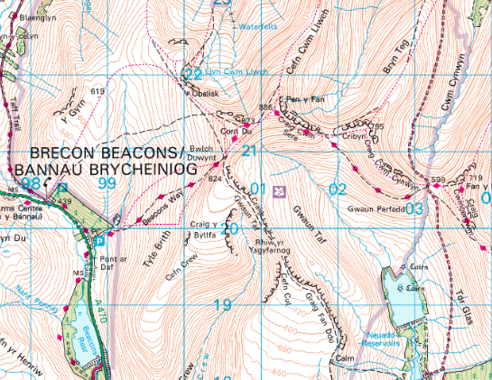
Easier to map to programmes via SSA ( Sector Subject area)

Slide 35
Sector Subject Area(SSA) analysis based on QiW data @23/08/16
Sector subject area (SSA) | @23/08/2016, 16:02
1st tier code |  |  | Number | Per cent | Rank
1. Health, public services and care |  |  | 854 | 8 | 5
2. Science and mathematics |  |  | 275 | 3 | 12
3. Agriculture, horticulture and animal care |  |  | 394 | 4 | 11
4. Engineering and manufacturing technologies |  |  | 1,379 | 14 | 2
5. Construction, planning and the built environment |  |  | 744 | 7 | 6
6. Information and communication technology |  |  | 275 | 3 | 12
7. Retail and commercial enterprise |  |  | 1,255 | 12 | 3
8. Leisure, travel and tourism |  |  | 547 | 5 | 9
9. Arts, media and publishing |  |  | 729 | 7 | 7
10. History, philosophy and theology |  |  | 74 | 1 | 15
11. Social sciences |  |  | 75 | 1 | 14
12. Languages, literature and culture |  |  | 600 | 6 | 8
13. Education and training |  |  | 395 | 4 | 10
14. Preparation for life and work |  |  | 1,388 | 14 | 1
15. Business, administration and law |  |  | 1,190 | 12 | 4
Total |  |  | 10,174 | 100

Slide 36
Qualification type
Qualification type |  |  | Number | Per cent | Rank
Advanced extension award |  |  | 1 | 0 | 19
CVET |  |  | 31 | 0 | 10
English For speakers of other languages |  |  | 39 | 0 | 9
Essential skills Wales |  |  | 16 | 0 | 14
Entry level |  |  | 131 | 1 | 7
GCE A level |  |  | 255 | 3 | 5
GCE AS level |  |  | 252 | 2 | 6
GCSE (9-1) |  |  | 1 | 0 | 19
General Certificate of Secondary Education |  |  | 379 | 4 | 3
Higher level |  |  | 24 | 0 | 11
IVET |  |  | 20 | 0 | 12
Key skills |  |  | 63 | 1 | 8
National Vocational Qualification |  |  | 19 | 0 | 13
Occupational qualification |  |  | 2 | 0 | 18
Other general qualification |  |  | 391 | 4 | 2
Principal learning |  |  | 7 | 0 | 17
Project |  |  | 13 | 0 | 15
QCF |  |  | 8,266 | 81 | 1
Vocationally-Related Qualification |  |  | 256 | 3 | 4
Welsh Baccalaureate |  |  | 8 | 0 | 16
Total |  |  | 10,174 | 100.0
Notes:
Sum General education 887, Per cent 8.7
Sum General +Other general Qualification 1,278 , 12.6 per cent
BTEC in Name 925, 21.7 per cent
88 distinct learning activity type names in 1162 learning activities currently compared to 20 qualification types.
242 programs listed

Slide 40

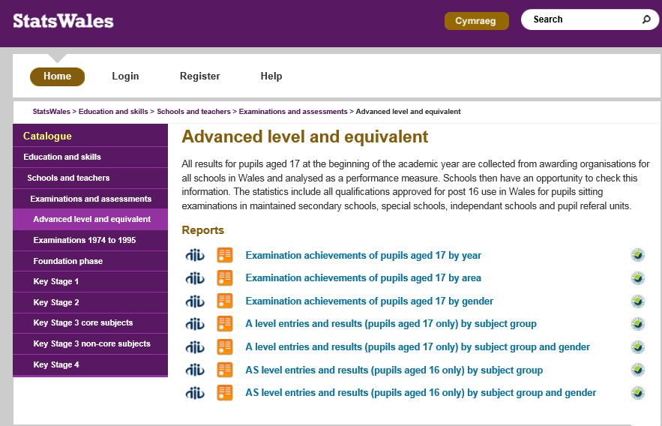
  Easier to map attainment to awarding organisations statswales

Slide 41

  Single source of data for all stakeholders

Slide 42

  Schools/LAs can calculate performance data for self evaluation

Slide 43
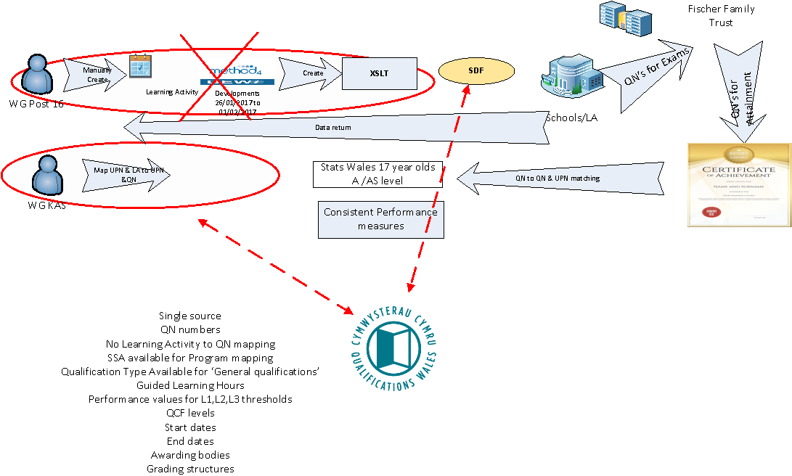
Leaner processes

Slide 44

What do software suppliers have in their systems currently for QNs?
QIW

Slide 45
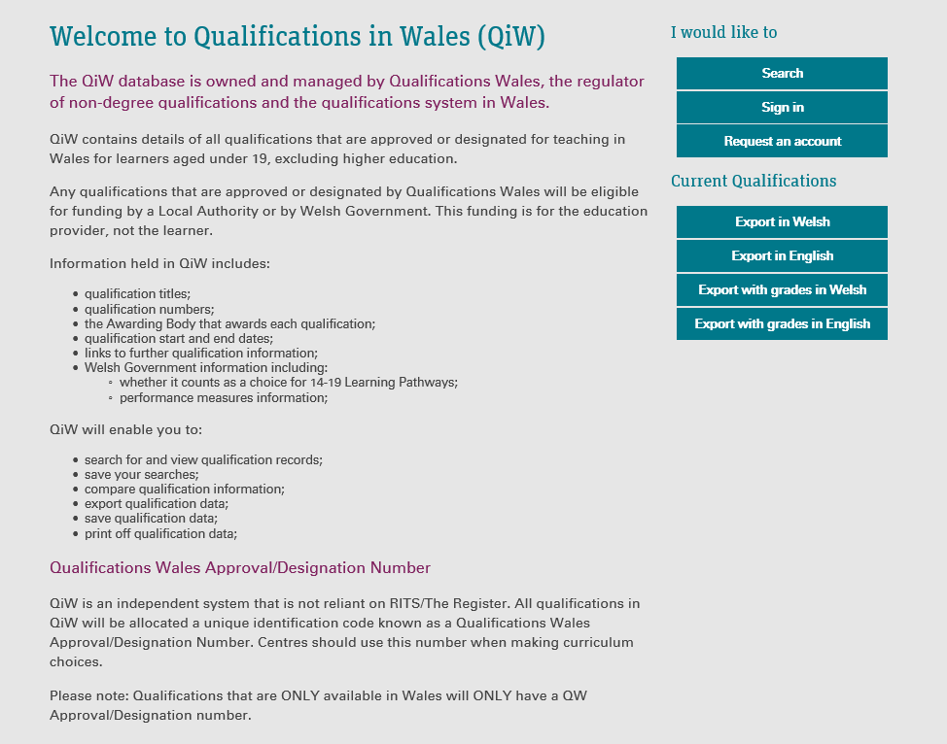

Slide 46
Issues encountered in England
Issues mapping QN to Awarding Bodies for attainment data
Running Learning Aims in parallel with QN

Slide 47
Format of QN
Qualifications delivered in Wales and not in England will have a QWAN not a QN.
  QN (Qualification number) format:
100/2928/X (nnn/nnnn/A) n= number/integer (0- 9) , A= ‘X’ or integer (0-9), 10 characters (CHR10)
  QWAN (QW Approval/Designation No.) format:
C00/0000/2 (Ann/nnnn/n) A=‘C’, n= integer (0-9), 10 characters (CHR10)

Slide 48
Learning Activity format
3210128E (nnnnnnnA) n= number/integer (0- 9), A = ‘E’ ,8 characters (CHR8)
Two less characters than QWAN or QN

Slide 49


What do software suppliers need from WG?

Slide 50
Automation of Guided Contact Hours

Slide 51



Next steps and close

